Slide 1
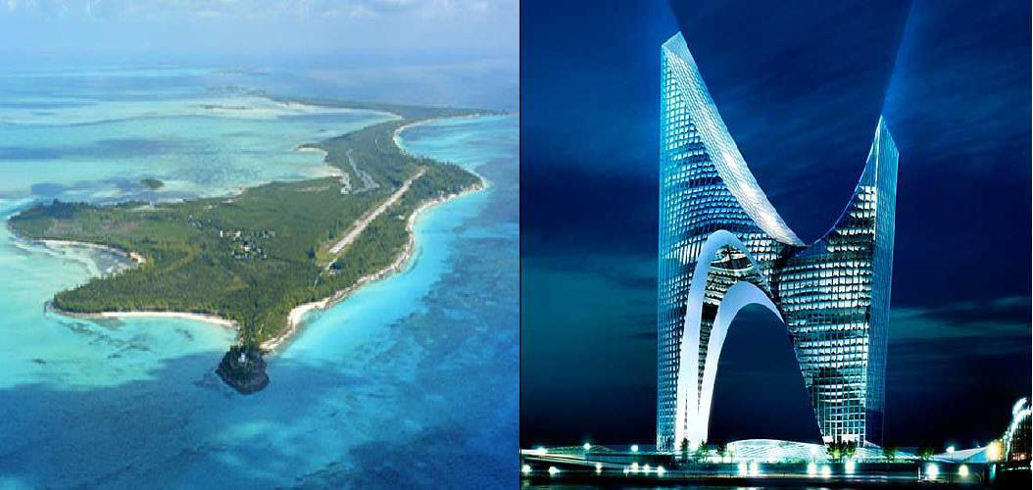
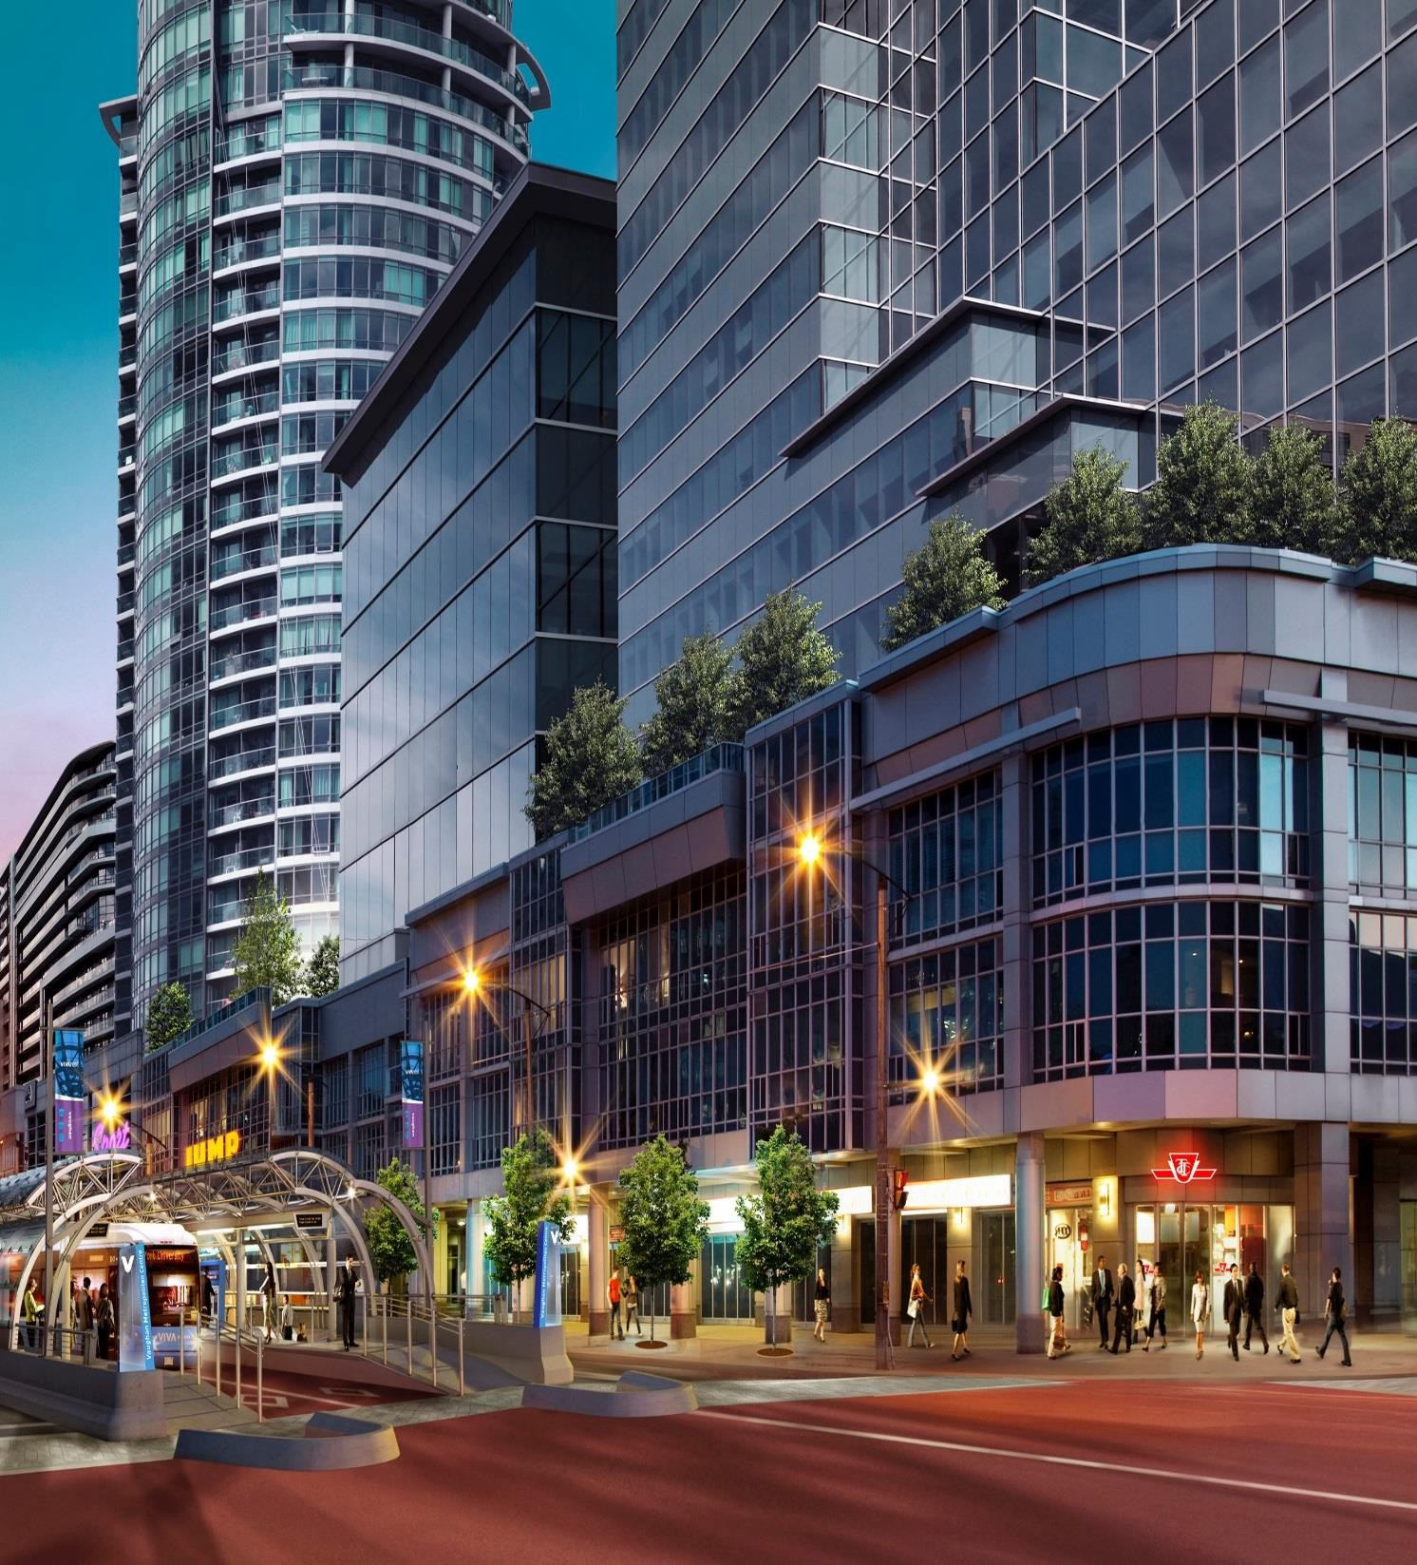
The City of Avalon (GY) Investor Presentation

Slide 2
Executive Summary
VERSION 1
We are seeking equity investment partners for our USD $1,500,000,000 developments stated in this summary.
The City of Avalon
The Oasis 300 Rooms Futuristic Private Island Resort.
The Oasis Country Club Community

Slide 3






Executive Summary
VERSION 2
We are seeking equity investment partners for our USD $1,500,000,000 developments stated in this summary.
The City of Avalon
The Oasis 300 Rooms Futuristic Private Island Resort.
The Oasis Country Club Community

Slide 4
Executive Summary
The Republic of Guyana is a country on South America’s North Atlantic coast and is defined by its diverse rainforest. Guyana is the only English-speaking country in the South American continent. It is bordered by the Atlantic Ocean to the north, Venezuela, Brazil and Suriname, west, south and east respectively. Guyana is a culturally diverse country and is a land of six peoples. While it is essentially not part of the traditional Caribbean, it is a founding member of the CARICOM and is the home of the CARICOM Secretariat.
Guyana’s economy has stabilised and there is a projection for massive economic growth with its major oil find offshore, since 2015. There has been massive investment in the oil and gas sector and travel to Guyana has increased especially among expats who are seeking to acquire homes here. This coupled with the already existing limitation of the government to provide suitable housing for Guyanese creates a niche market for our Company.
Fabulous Homes International has been in the housing development market in Guyana since 2010 and have since expended in excess of USD 3,000,000.00 in its housing projects.
The Company's mission is to provide affordable housing for Guyanese of all classes. In this regard, and capitalising on the limitations of the Government, the Company has embarked on several projects and intends to expend USD 1,500,000,000.00 on the development of several housing developments, such as the City of Avalon, The high tiered Golf and Country club community, the Oasis Country club and our futuristic 300 room Private Island Resort community.
We are developing each projects infrastructure, roads, drainage, water, electricity, recreational facilities, shopping malls, and homes. All
these projects will be fully gated with 24 hours security. Propitiatory works for all these projects have began.

Slide 5
Executive Summary
We are a property development organization which specializes in providing all the requisite services that enable deployment projects to be successfully completed through the medium of designing, construction and management of projects. We offer a “turnkey” method of operation.
Our clients‘ objectives are satisfied through a team of highly qualified professionals including project managers, architects, mechanical, electrical, plumbing and civil engineers, management and financial consultants and a wide range of construction support personnel. Fabulous Homes International is therefore equipped to facilitate and manage all phases of each project which we undertake.
Our network of expertise is structured to provide prompt attention to any specific need thus ensuring that projects are completed on time and within the established budgets.
The impetus for providing an array of comprehensive services stem from the demand for architecturally sound and environmentally friendly planned urban communities that are designed specifically for developing countries in the Caribbean and Latin America. The primary objective of Fabulous Homes International is to develop a balance between the existing environmental conditions and the critical urban planning needs for the development of new towns, satellite cities and adequate housing together with the necessary infrastructure for the development of new communities.
Fabulous Homes International takes great pride in its ability to successfully execute projects with honesty, integrity and a high degree of professionalism and also in its ability to meet and exceed our clients’ expectations. Fabulous Homes International utilizes the professional service of several technical and specialty consultants in the execution of projects. These resources offer a wealth of experiences and have been used in the past on several projects.

Slide 6

Dr. Karis O. Munroe President & CEO of Fabulous Homes International Group Of Companies (1 of 2)
Dr. Karis Munroe, also known as the “Caribbean Queen of Real Estate, is Queen of bootstrapping to millions. An innovative and cutting-edge leader, Founder and CEO of multinational corporations, Fabulous homes International Group of companies. A diversified investment group in Guyana South America, with one of the fastest growing luxury real estate brokerages with a virtual presence in 49 territories across Guyana, the Caribbean, and the Latin American region, currently number six in the region, plus the developer of the pre- developing City of Avalon in Guyana South America. She is relentless in all of her pursuits and is most recognized for her fortitude and resilience.

Slide 7
Dr. Karis O. Munroe President & CEO of Fabulous Homes International Group Of Companies (2 of 2)
Over the last twenty years, Dr. Munroe and her team have sold over 3,000 properties in the United States, Caribbean, and South American markets as a premier resource on global real estate trends. Through a four-year extensive feasibility study, Dr. Munroe and her team created a solution to make homeownership affordable and accessible for all. By taking the once complicated homeownership process and simplifying it through the #Project5000 platform, Dr. Munroe has positioned herself as a leader in real estate development and innovative alternative financing techniques. As one of the largest black-owned real estate developers in the Caribbean & Latin American region, her company, Fabulous Homes International is headquartered in Guyana, South America and manages operations across 49 territories virtually. Dr. Munroe is an active member of several trade associations as well as the founder of the Caribbean Association of Real Estate Professionals.

Slide 8
Project Team
Dr. Karis Munroe
Real Estate Development
Allison
Collymore
Architectural Engineering
Sherwin
Benjamin
Corporate Law
Olsen Munroe
Operation Project
Management
Dwight Scott
Project Management, Marketing PR
Timothy Noel
Accounting, Pearl Munroe: Compliance.
We have attached a short bio about our team members whom together our experience spans over 100 years in Real Estate Development and other complementing industries.

Slide 9




Ownership
The City Of Avalon
FHI Media
100%
100%
Futuristic Oasis Resort
Dr.Karis Munroe
100%
FHI
Corporation
100%
100%
Fabulous Home Int’l Group Of Companies
100%
The Oasis Country Club
100%
100%
FHI Land Trust
GNHT
Finance Corp

Slide 10


Guyana, according to world bank Data, is the fastest growing nation in south America and the Caribbean (1+ M people). growth (2011
- 2016). Population estimated to increase by 329,517 in
Dec 2021.
Ranked 2nd
in Caribbean for Best Places for Business. From 2015 - 2020
Guyana had an average of 3.5% business growth.
Employment Largest employment center in the Region
accounting for 38% of total employment.
From 2006 - 2016,
there was an average of 3.5 % employment growth

Slide 11
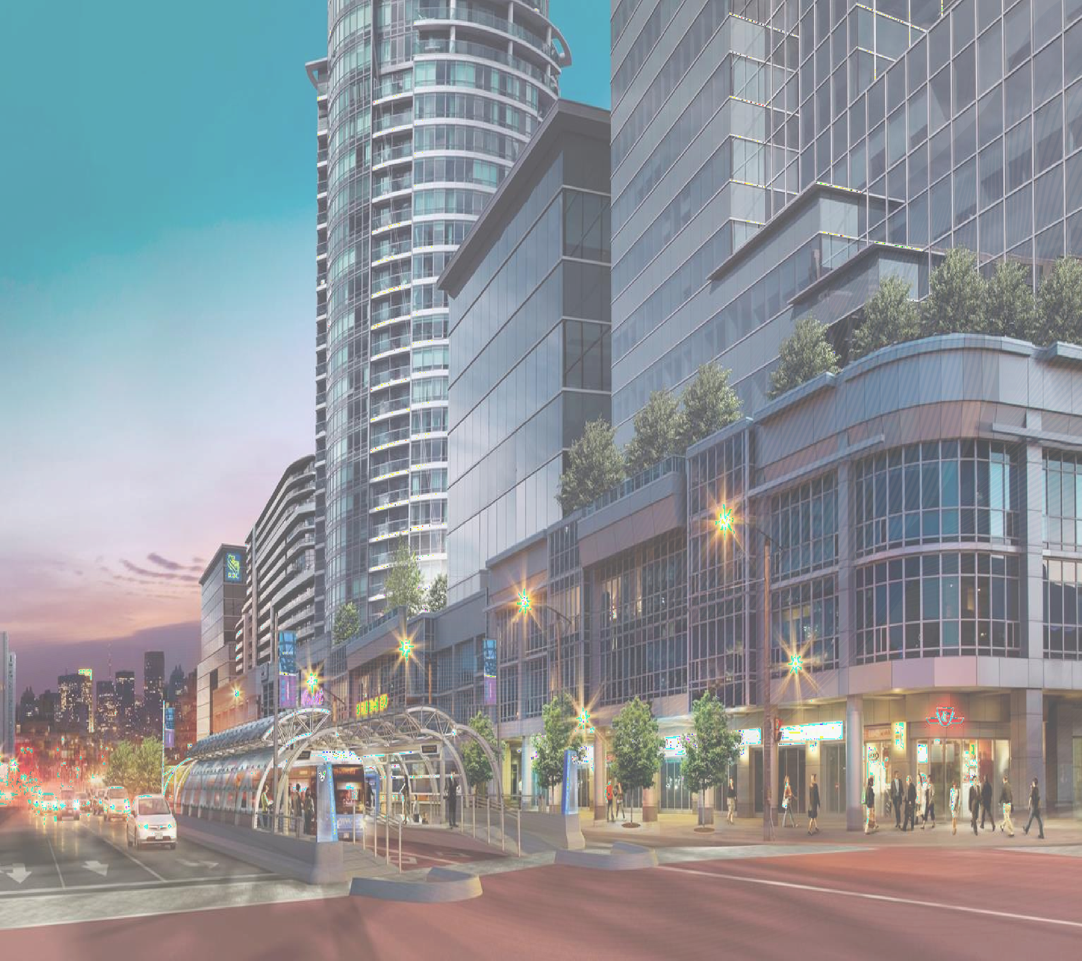
The City of Avalon (GY)

Slide 12
About The City of Avalon http://thecityofavalongy.com
As we position ourselves to be one the Best Place to live in Guyana. We are tapping into to the housing boom as a result of the discovery of Black gold in this country, currently taking place in Guyana today. Due to the overcrowding in the urban area such as Georgetown and its surrounding environs, it is imperative that quality affordable housing is developed within thirty minutes from the capital city.
The availability of land for housing is becoming scarcer each year and the government has indicated that new housing development opportunities will be available along the east bank corridor. There is great indication that lands in that area will be used to create new industries thereby creating a demand for affordable quality housings along this corridor.
Guyanese returning home are also seeking quality affordable homes and villas they have grown accustomed to in North America and Europe.
The City of Avalon is poised to provide not just a quality home at an Affordable price, but auxiliary services from state of the art health care services and providers, fire service, police department, Avalon private security firm, private clinics, private schools(from Daycare/PREK- to University), first class entertainments strip with first class nightlife, from upscale restaurants, soft commercial ranging from Avalon coffee shop/and a multiplicity of other local fast food attractions/Avalon Auto Dealerships/ Avalon Tech Center & Incubation hub)movie theatres, Malls, an amusement park, Senior Citizen Active Lifestyle home, golf Course, Hotels, recreational parks, gas stations with mini mart, credit union, supermarkets, Laundromats, salons & barbershops, casino, hardware stores etc) For Light Industrial Avalon Energy/Avalon Transportation Terminal, Avalon Water bottling Facility/Avalon Furniture factory/Avalon Building System factory(Sawmill, Block Making& Composite wood factory /Boss Communication phone, cable & internet service provider, one solar farm plus 20 acres designated to aquaponics farming.
Based on #Project5000 Homeownership platform our current client composition is 57% remigrant with 5% from the expat community along with 38% from our local professional community. Our mission is revolutionizing the housing industry offering our residents, American styled quality homes at an affordable price.

Slide 13

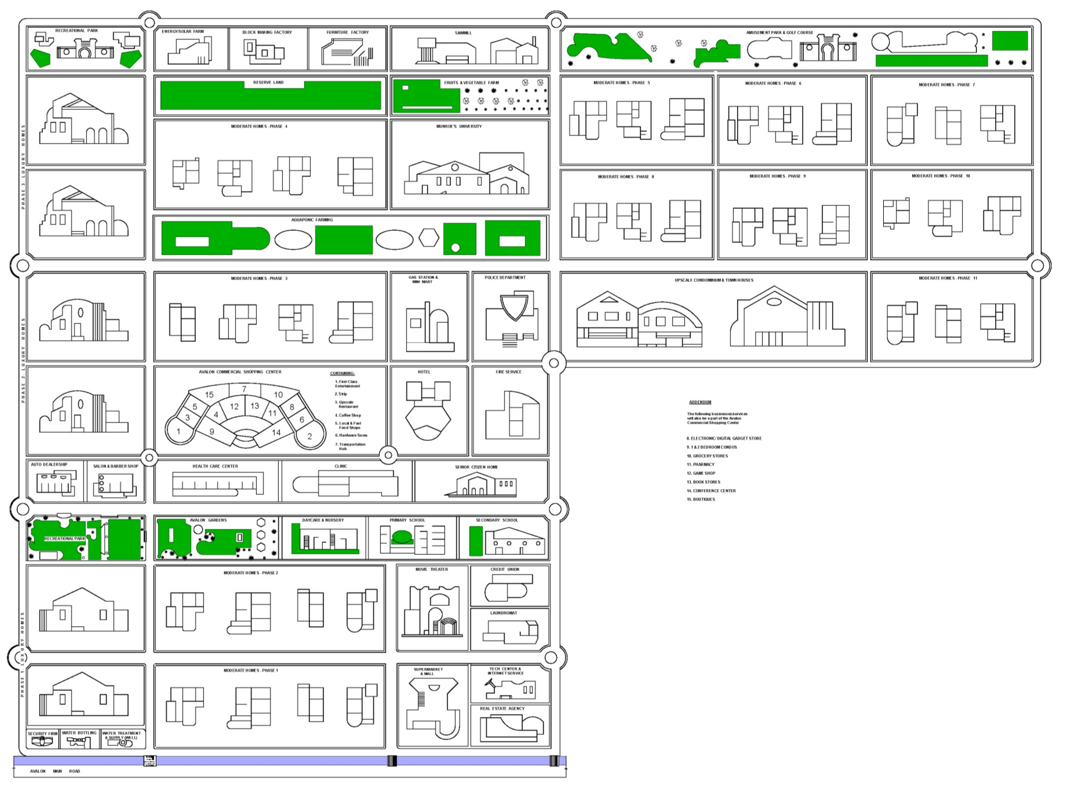
Concept Layout for The City of Avalon

Slide 14
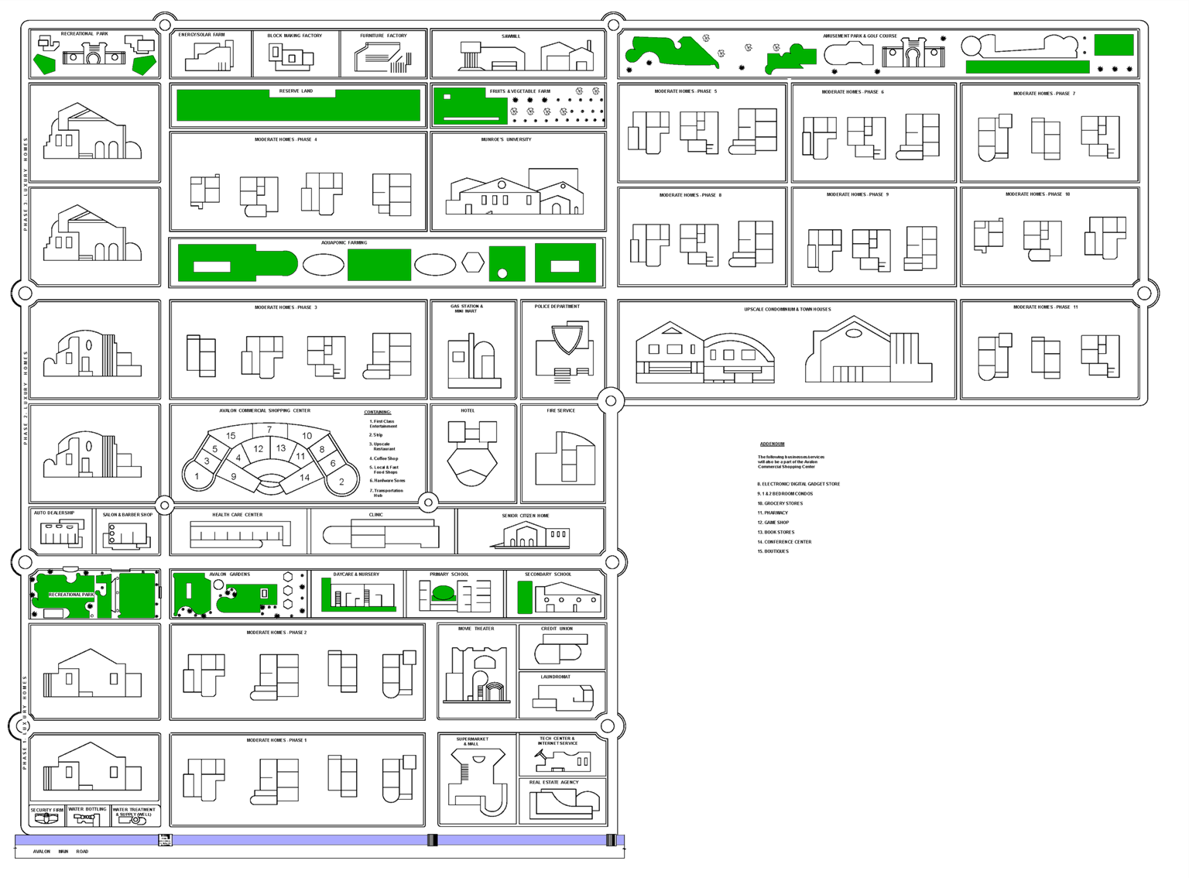
Concept Layout for The City of Avalon
VERSION 2

Slide 15
Intelligent City of Avalon
Led Lights
Citizen Experience
Smart Traffic Lights
Smart
Meters
Munroe University
Avalon Mesh
Digital Literacy
Tech Incubator
Avalon Transit
AI
AVLBOTS
Innovation & Research Lab
Internship Div.
Super
Cluster
SCADA
Digital Transformation
Smart City
Challenge
INTELLIGENT
CITY
Startups
AVEN
Smart City
Task Force
Smart City
Task Force

Slide 16
About The City Of Avalon
We are creating a modern-day city •
for both citizens and non-citizens with
additional benefits to include:
Jobs for residents
Small Business Opportunities through Avalon tech and Incubation Hub
Access to healthy organic foods
Accessibility to State-of-the-Art Affordable Health care services
Low-cost public transportation throughout Avalon
Affordable Homeowners Association fees
Green Community using primarily green energy with no power outages
Access to Financing for home loans/HELCO/Refinance/Small Business Development
The City of Avalon is an innovative, self-sustaining real estate development that caters for moderate, middle to high income families. Our Approach is to create Sustainable Development through Economic Empowerment
This City will be Developed and Managed by the Management and Board of Directors of Fabulous Homes International.

Slide 17
The Ask:
We are seeking equity investment partners for our USD$800,000,000 one of a kind 5000 Homes Mixed use community, complete with airport, water/amusement park, shopping malls, golf course, hotels, schools (Pre-K to University), hospitals, clinics, a fully self-sustaining community run on solar/wind energy.
800 of the 2000 acres of land have been purchased and in pre-development with over sixty homes at different phases of construction, the remaining 1200 acres is available for purchase for USD$50,000,000 with $750,000,000 as the infrastructure balance. We will sell Moderate, Middle and Executive homes to our current client base of over 10,000 strong that range from the local upper middle class, remigrating Guyanese and the booming expat community. We will also provide homeowner's insurance, extended home warranty, HOA & utility services.

Slide 18
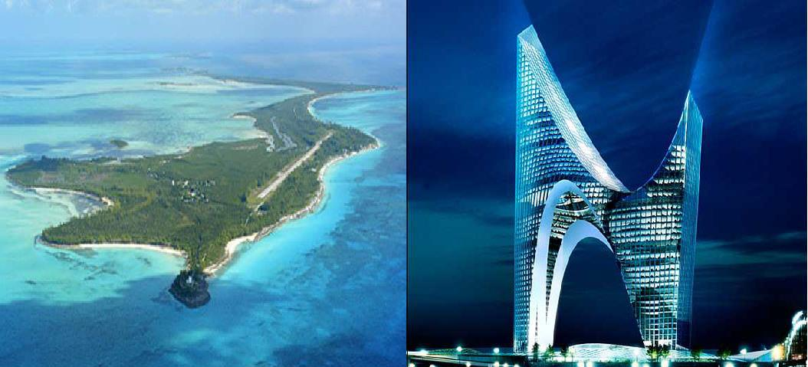

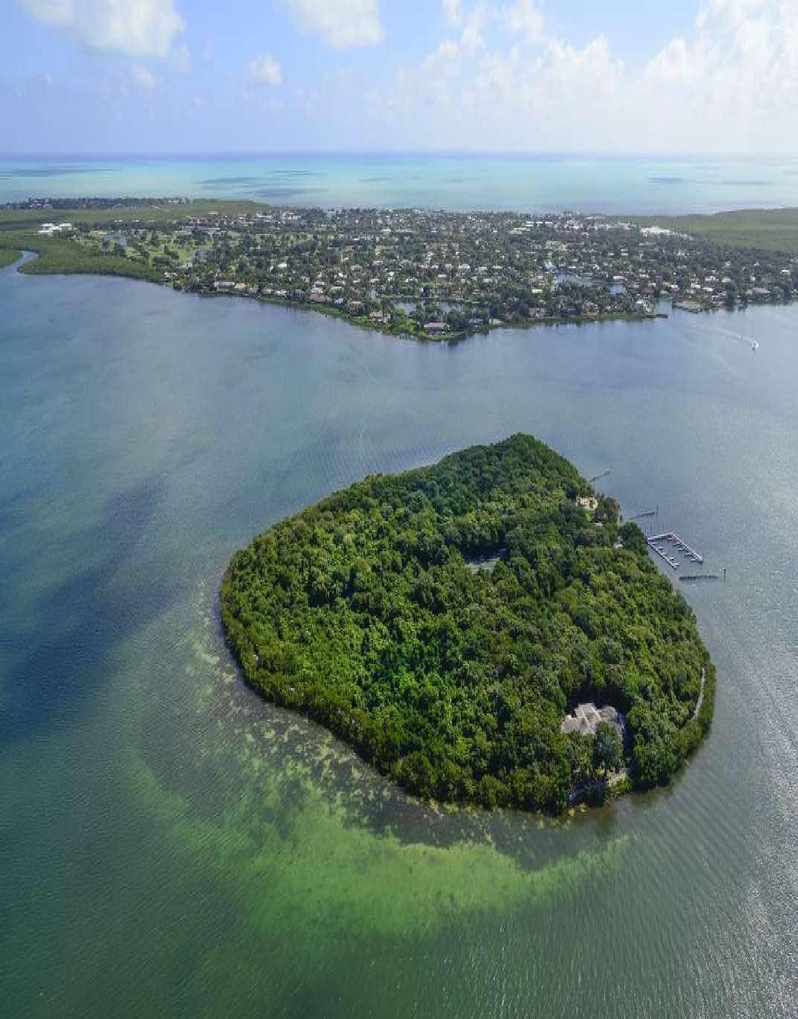
FUTURISTIC PRIVATE ISLAND RESORT COMMUNITY

Slide 19
The Ask:
We are seeking equity investment partners for our $400,000,000 one of a kind 300 room futuristic island resort complete with airport, cruise ship port, marina, yacht birth, castle, water/amusement park and fisheries; completely self contained and run on solar/wind energy.
The 811-acre island is available for purchase for $80,000,000 with
$320,000,000 as the infrastructure balance. We will sell executive travel club membership to celebrities, yacht and aircraft owners and to the average discriminating traveler.

Slide 20
About the Development (1 of 2)
Island is 30 minutes by boat from Parika, Its a 30-minute flight from Timehri International Airport and 10 minutes from Bartica. Has been privately owned since the early 1900′s and spans 811+ acres of lush, ecologically unspoiled land with high elevations and extraordinary white sand beaches. This L-shaped island has over fourteen miles of waterfront property surrounded by coral reefs and deep water. Located at the tongue of the Essequibo river, this island boasts some of the best fishing and diving in Guyana.
The prospective owners will have full control of the island and own 94 per cent of the land. The island is sold with outline planning consent to develop the land into a luxury private island resort, with commercially operated airstrip, marina, hotel and resort homes.
We propose to build a 1 of a kind Futuristic City on The Main Peninsula located on the far west side of The Main Peninsula. This concept will provide executive housing accommodations, Magical Restaurant and Bars, A Casino, Pilots Club with future animated rides and driving skills and complete city infrastructure. “Jetson Cartoon” style spacecraft between buildings.

Slide 21
About the Development (2 of 2)
A Complete Self-Contained Infrastructure using Wind/Solar Hybrid Energy, A Reverse Osmosis and Treatment Plant and Alternative Energy Grid that provides FREE ALTERNATIVE ENERGY and a Monorail Transportation System
A cruise ship terminal and yachting community will be built on the northwest lagoon just east on the futuristic city, a private couple's Polynesian hut style community, an amusement and water park, water sports, airport and executive villa suits is proposed along the northern beachfront.
This resort and Entertainment Complex will combine first class accommodations with fine dining, magic, music, dance, fitness, spa and pampering. Feature local and International Entertainment and Talent and a mega variety of resort entertainment. The resort will feature our family’s 40-year seafood restaurant being resurrected “Guaranteed to best Fish-Chips and Coleslaw” you have ever tasted.
Our main income is derived from our Travel Club Membership ranging from $15,000-$100,000USD. Sold to
celebrities, sports stars, entertainment industry, yachting communities and RCI and II timeshare affiliates.

Slide 22
Planned Development Phases
This Investment Proposal is to build a first class 4–5-star resort complex in phases.
The first phase $200M at closing table to build the future resort on the main peninsula as well as the airport and cruise ship terminal and yacht docks, road and monorail. The beach cleanup and sand purchase will happen simultaneously
The second phase $40M at 5 months to build the solar/wind energy plants and grids
and provide power to the 1st phase and start the vegetable and seafood farm
The third phase $10M at 7 months to build the reverse osmosis and sewage/treatment plant and water/fuel tank placement and complete the first phase and make it the resort operational. The resort airplane will be purchased at this time to commence daily flights
The fourth phase $50M at 9 months to build the amusement and water park and complete the purchase of entertainment and watercraft tour operations
The final phase $100m at 12 months to build the beach villas and Polynesian huts
Total Soft Cost:
  $35,000,000USD
  Administrative, Sales and Marketing, Salaries, Supplies

Slide 23
Financial Projections
 | Year 1 | Year 2 | Year 3
Resort net profits | $18,947,562 | $22,152,630 | $25,022,034
Resort expenses | $11,848,000 | $11,648,000 | $11,648,000
Total resort profits | $7,299,562 | $10,504,630 | $13,374,034
Other net profits | $49,801,246 | $54,971,438 | $60,141,654
Other expenses | $19,920,498.4 | $21,988,575.2 | $24.056,661.6
Total other profits | $29,880,747.6 | $32,982,862.8 | $36,084,992.4
Total NOI | $37,180,309.6 | $43,487,492.8 | $49,459,026.4

Slide 24
This Resort Income Will Come From Several Sources...
Futuristic 300 room resort- main peninsula
Beachfront villas
Polynesian Huts
Several restaurants and bars
Pilots club membership lounge
Storefront owners
Marina
Yacht and boat storage
Yachting and boating dockage and fees
Cruise ship profits
Airline profits

Slide 25
Exit Strategy
We plan on keeping this resort as a long-term asset and seek a long- term loan. This resort will be a feature Caribbean Resort Destination for many years to come. It is designed to be a totally self
sustained futuristic resort that can easily be transformed into different facades as the future progresses.
The resort repayment will be easily managed by the above “Strategy Repayment Income and Profits.” Timely Payments will be made to the mortgage holder until the loan is paid off or refinanced.
Our main source of income will come from our “Travel Club Membership Sales” with both on and offshore sales presentations to interested parties in The USA and International.

Slide 26
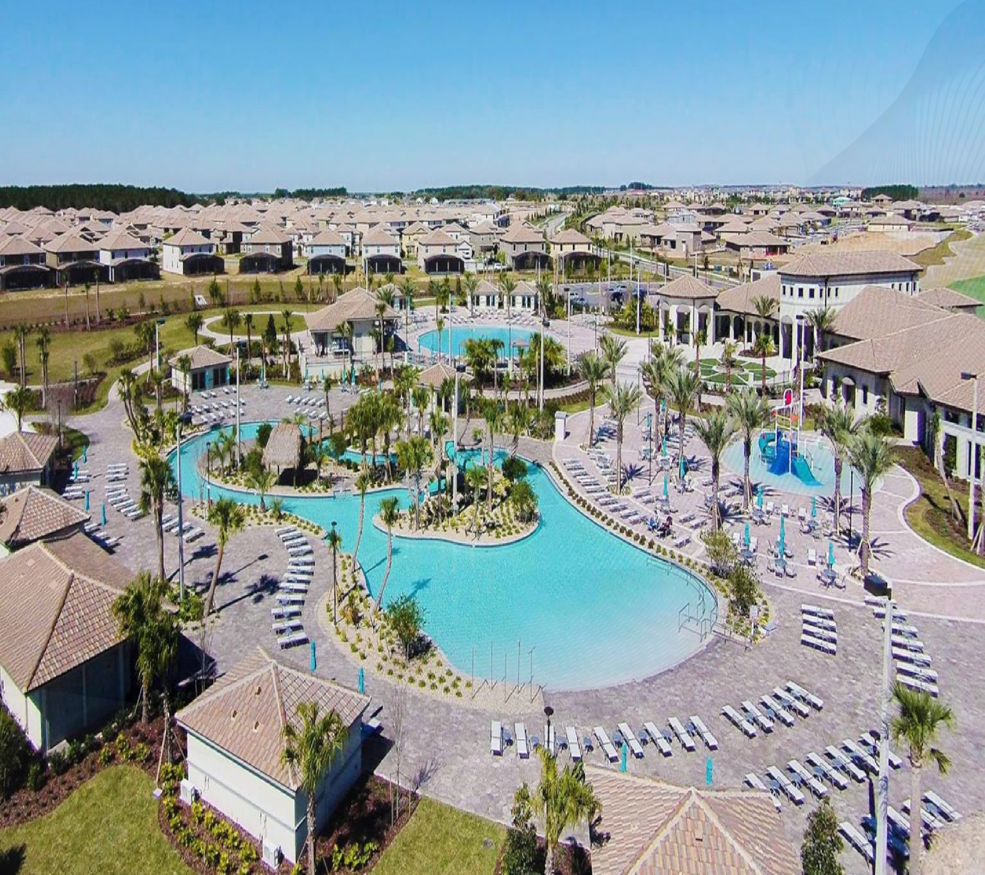
THE OASIS COUNTRY CLUB

Slide 27
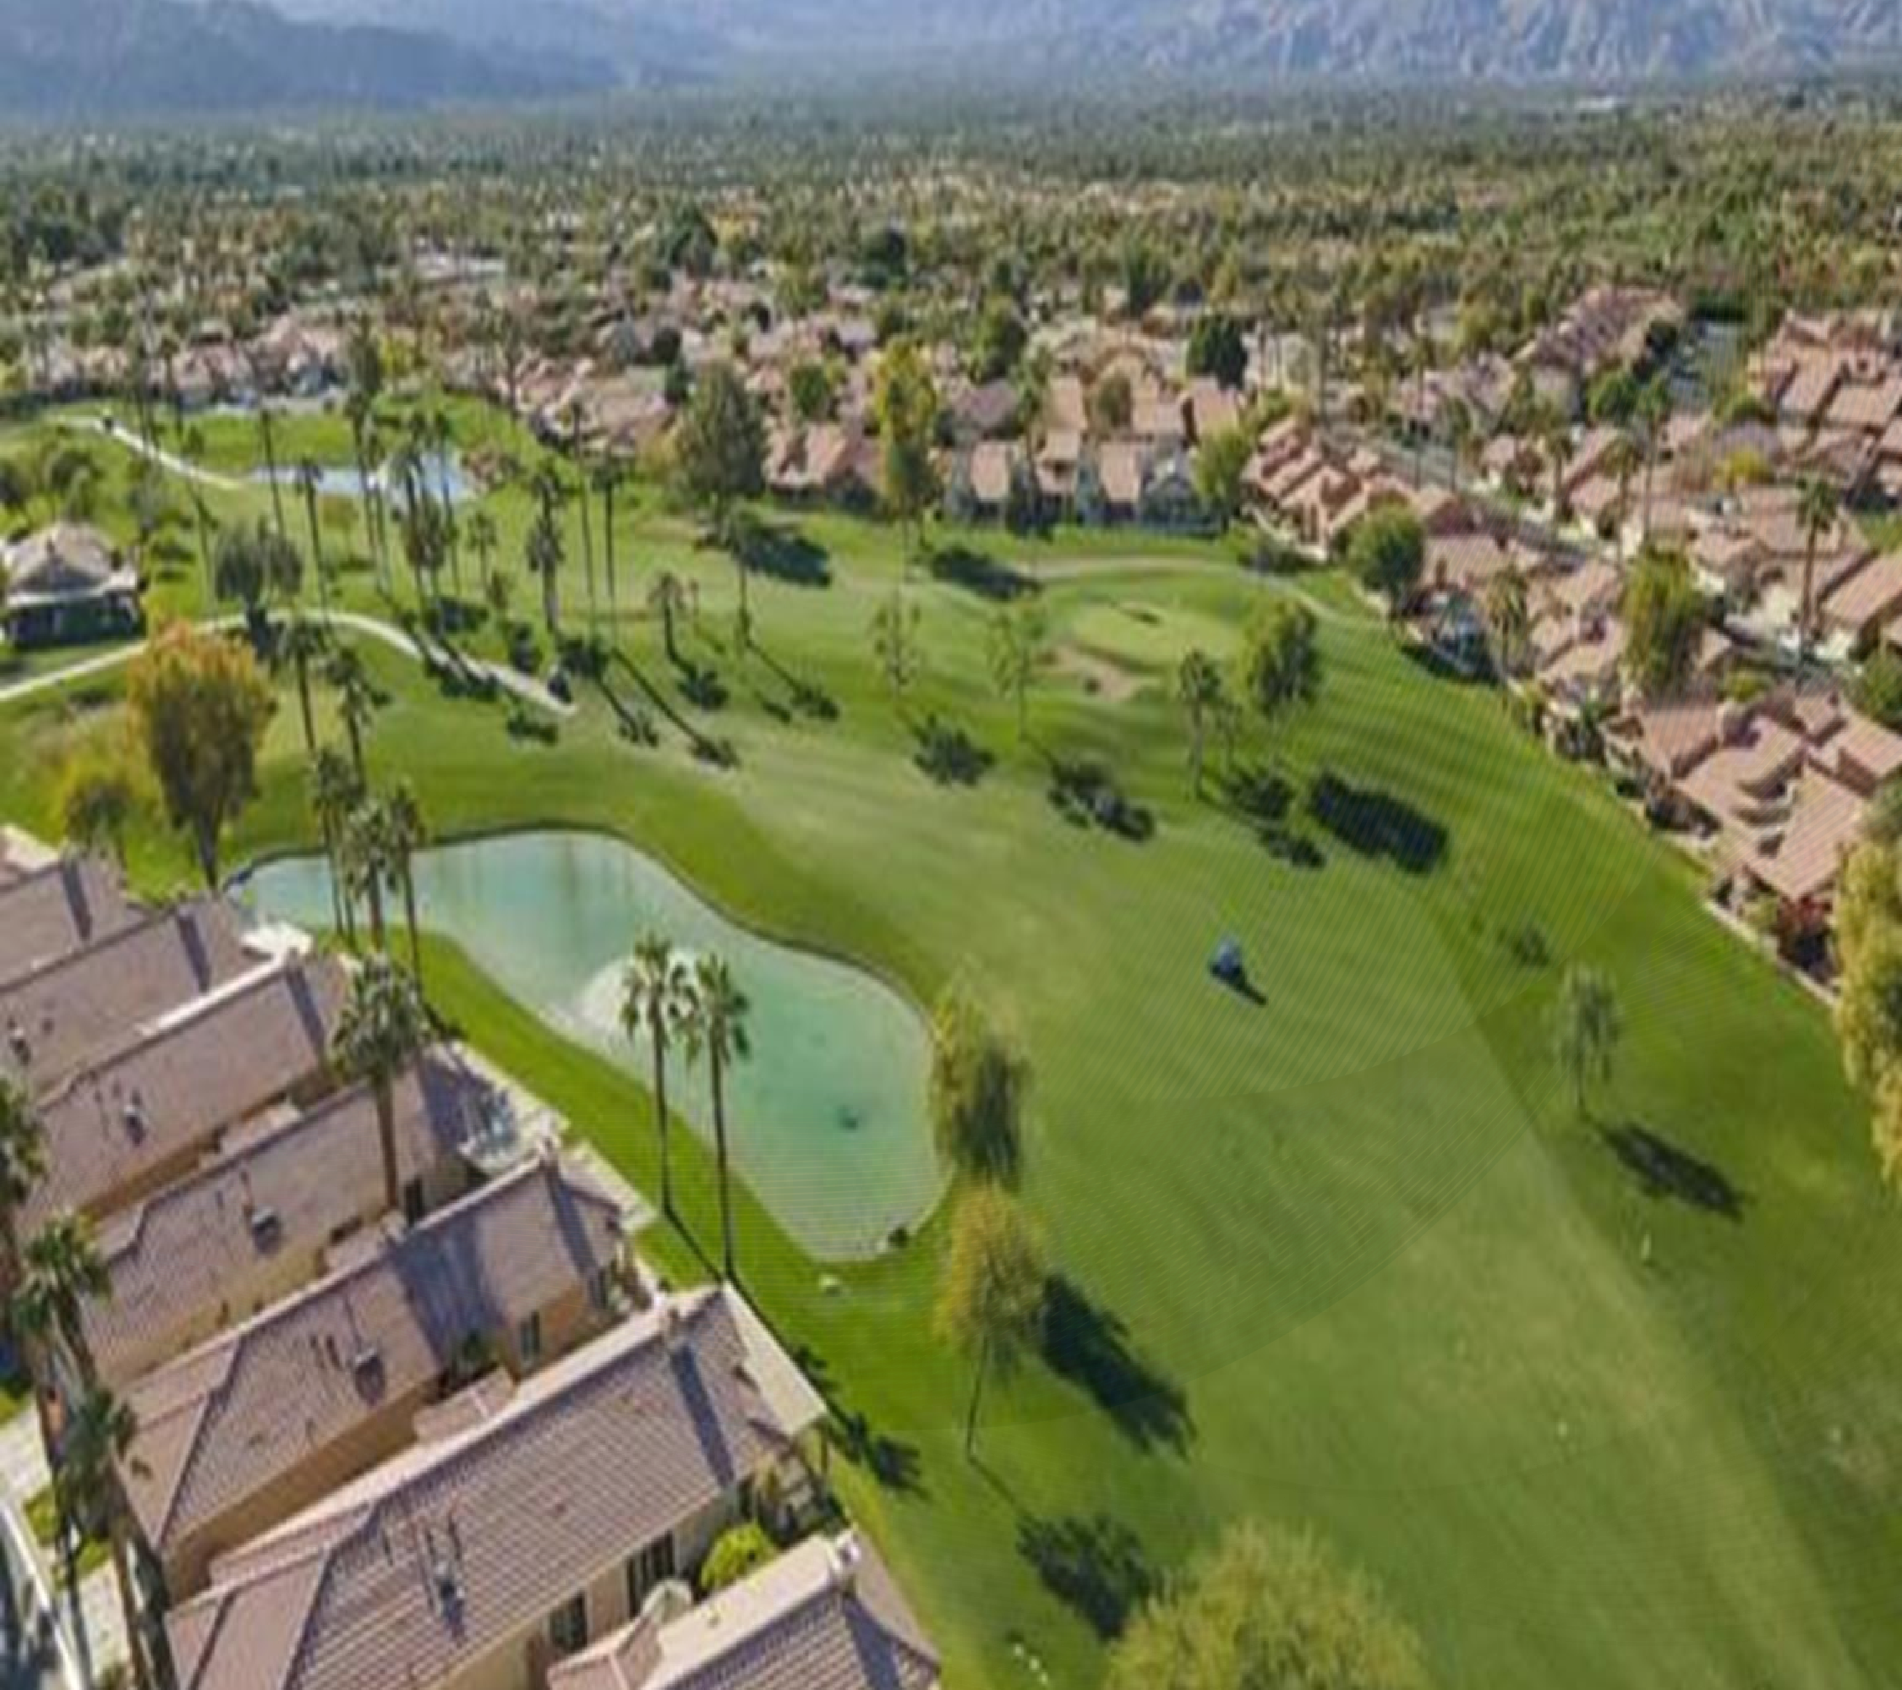

Slide 28
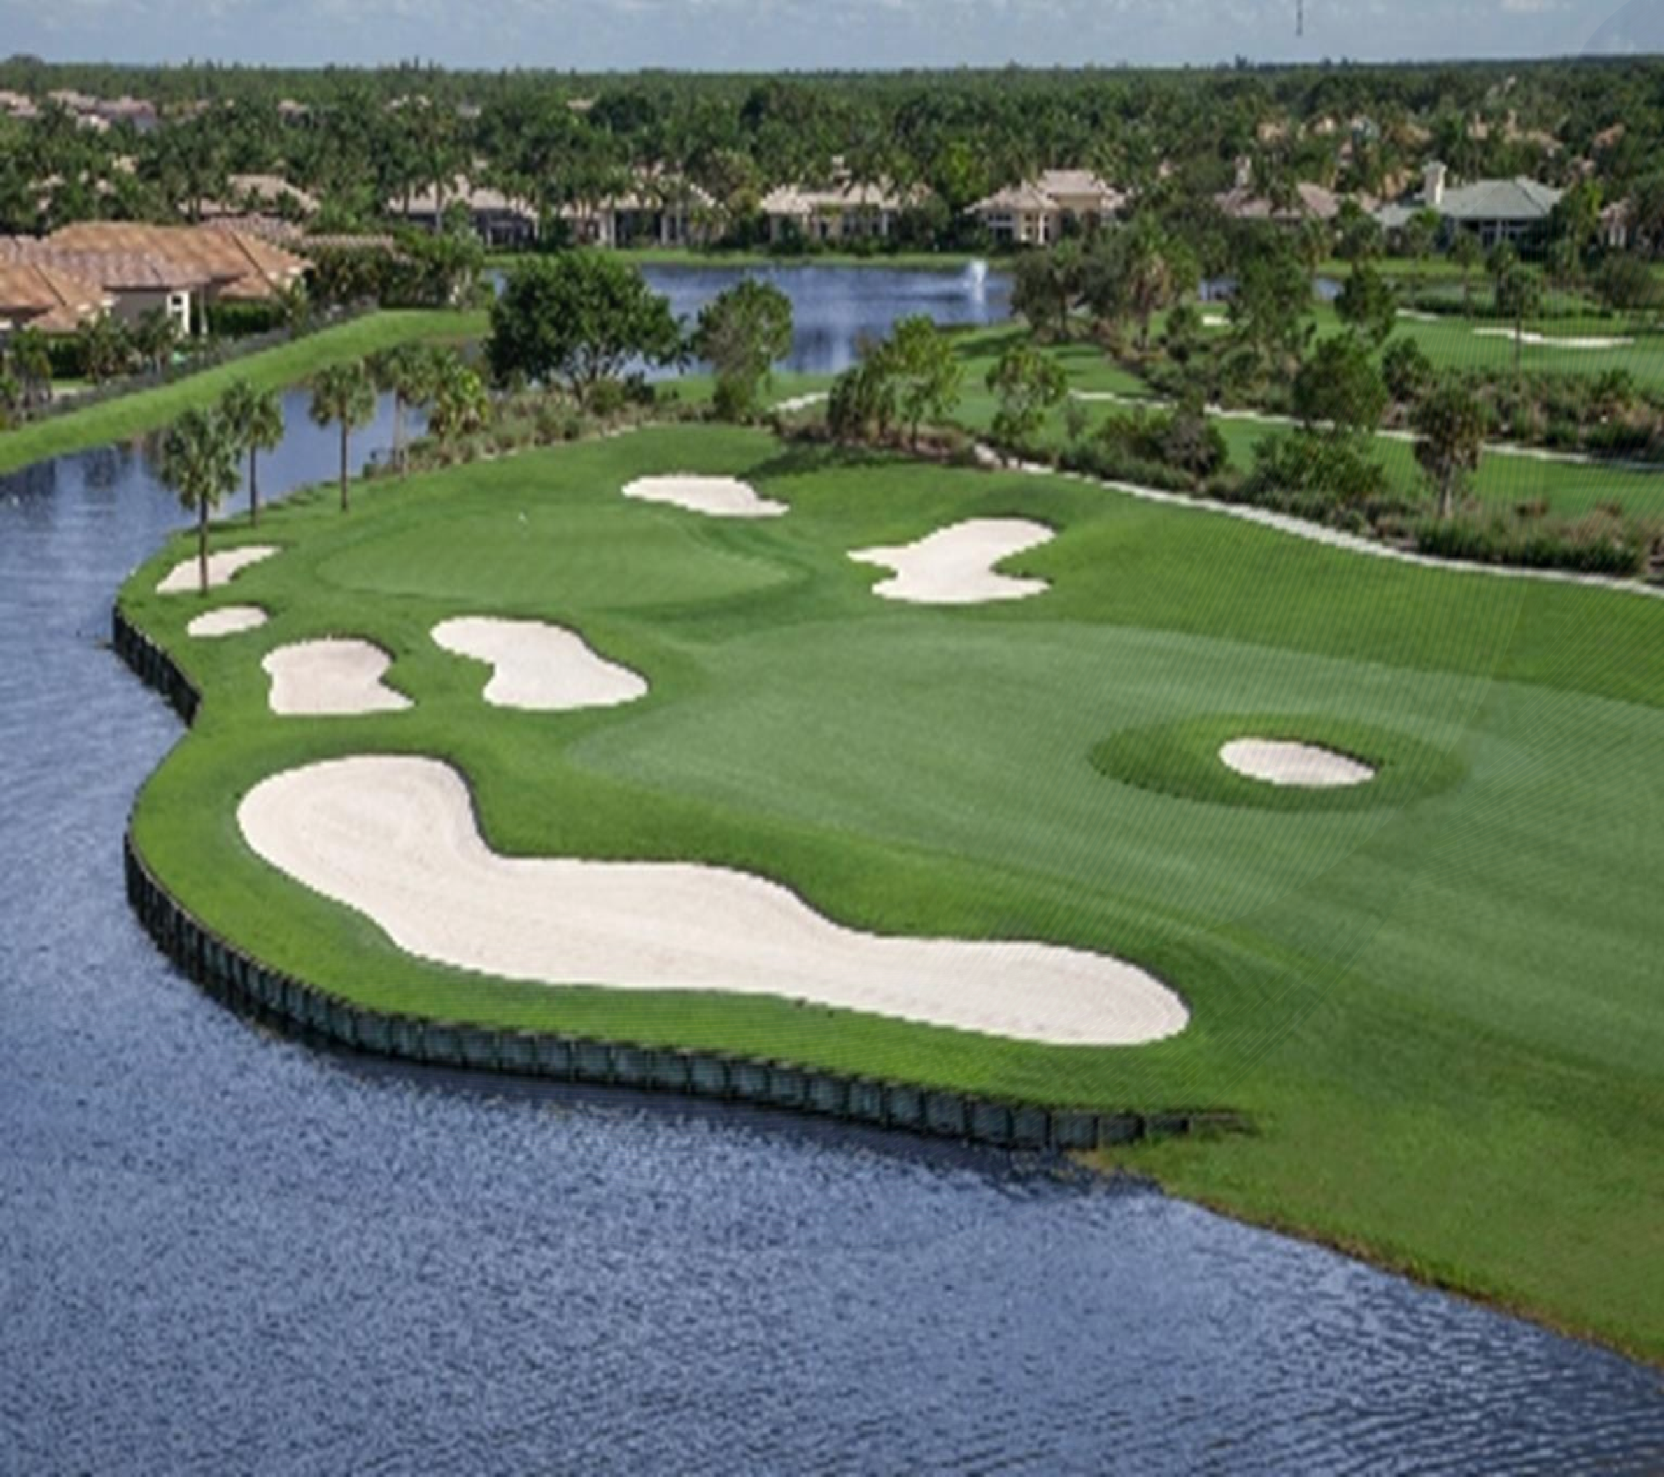

Slide 29
The Ask:
We are seeking equity investment partners for our USD$300,000,000 one of a kind Executive Luxury homes/executive Luxury Vacation homes, Golf & Yacht retreat styled Community for the opulent high net worth earner from the OIL & GAS Expat industry. This Community is complete with airport, marina, yacht birth, completely self sufficient and run on solar/wind energy.
The 309-acre island is available for purchase for USD$90,000,000 with USD$210,000,000 as the infrastructure balance. We will sell Executive Luxury homes and club membership to celebrities, yacht and aircraft owners, and to the average discriminating high net worth earner. See more here http://fabuloushomesinternationalguyana.com/oasis

Slide 30
About The Oasis Country Club (1 of 2)
Your vacation will be spent surrounded by the utmost luxury when you stay at The Oasis country club community. This one-of-a-kind resort consists of luxury executive homes and vacation homes fit for large parties, ensuring your Guyana stay will be one to remember. Between the fabulous villas, the incredible on-site amenities and the proximity to Bartica, you’ll be in the sweet spot for all of discerning clients and family’s vacation needs.
Play a round of golf or revel in fine-dining at a top-rated restaurant. Regardless of your interests, The Oasis country club promises endless enjoyment for everyone.

Slide 31
























About The Oasis Country Club (2 of 2)
The Oasis Country Club Community Amenities
Resort Style Pool with Water Slide & Cabanas
Lazy River
Tiki Bar
Fitness Center
Movie Theater
Games Room
Playground
Volleyball Courts
Public 18-hole
Golf Course
Golf Driving Range & Putting Green
Golf Clubhouse
& Pro Shop
6 Clay Tennis Courts & Tennis Clubhouse

Slide 32
The Numbers
FUND USAGE BREAKDOWN
THE CITY
OF AVALON USD$800M
LAND PURCHASE TOTAL USD$220MUSD
OASIS PRIVATE ISLAND USD
$400M
USD
$1.5 Billion
OASIS GOLF/
COUNTRY CLUB COMMUNITY USD$300M
INFRASTRUCTURE
$USD1.28B

Slide 33

Projects Chronology

Slide 34
Next Steps
Execution of financial agreement with investor & Fabulous Homes International.
With infrastructural development funded, Fabulous Homes International will proceed to mobilize within seven days firstly for the installation of temporary works and site accommodation. We would employ the use of our senior civil works engineers that will provide supervision of the project prior to continuation of work.
Secondly, we estimate that a construction workforce of up to 1200 persons for the duration of the works would be employed given the scale of development, it may be necessary to import labour from other regions in Guyana.
Temporary accommodation is provided for construction workers.

Slide 35
Currently in Development
http://thecityofavalongy.com
This Project is currently being Developed by http://Fabuloushomesinternationalguyana.com http:Fabuloushomesinternational.com
The Oasis Country Club Community http://fabuloushomesinternationalguyana.com/oasis https://youtu.be/EK2iJnP2Ohs
The Futuristic Oasis Private Island Resort https://youtu.be/R7aySkQqUIo
Others subsequent Projects Avalon Luxury Collection https://youtu.be/R0ApXHfYlcw
Our Sister Company http://guyananationalhousingtrust.com
EMAIL Dr. Karis Munroe: info@fabuloushomesinternational.com komunroe10@gmail.com

